Slide 1
CHAPTER 13: Ethernet and TCP-IP Networking
The Architecture of Computer Hardware, Systems Software & Networking: An Information Technology Approach
4th Edition, Irv Englander
John Wiley and Sons ©2010

Slide 2
Chapter Example
User sitting at a computer types a URL that contains a domain name into a web browser
First, HTTP client obtains the IP address of the Web server
Then HTTP client initiates the process with a request to the TCP socket to establish a logical connection with the HTTP server at the destination site

Slide 3
Domain Names and DNS Services
Domain Names
Hierarchical system of network address identifiers used throughout the Internet and on local area networks, intranets and extranets
Created so users would not have to memorize IP addresses
Domain Name System (DNS)
Domain name resolution – translates domain names into IP addresses
Uses a massive distributed database containing a directory system of servers
Each entry contains a domain name and an associated IP address

Slide 4
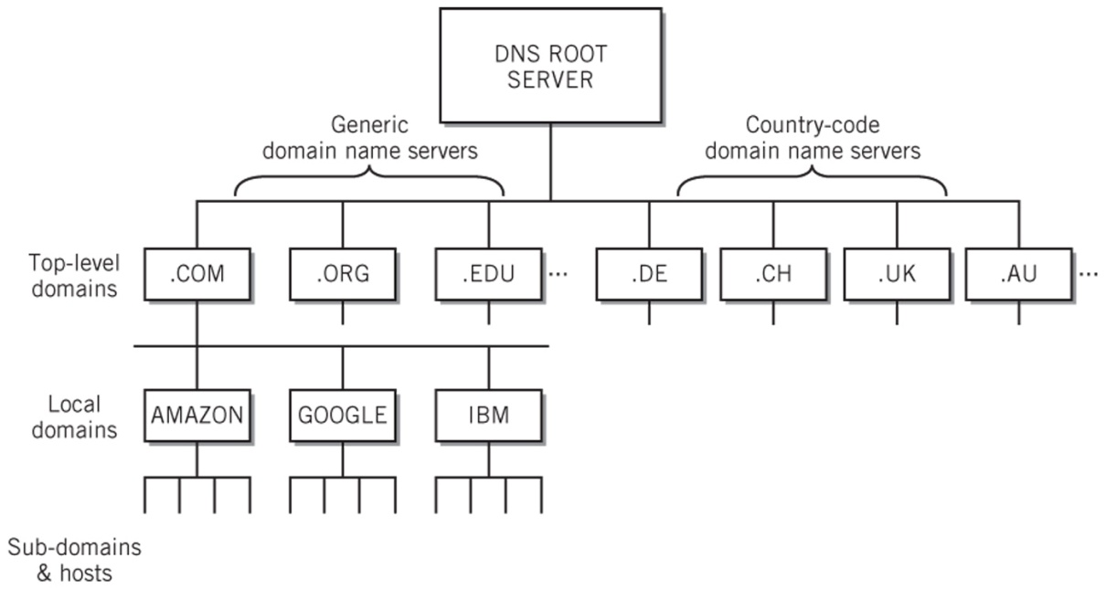
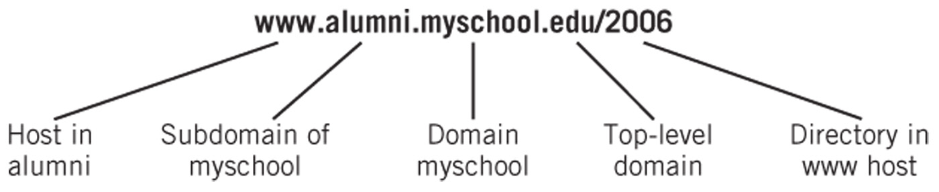
Domain Name System (DNS)
DNS Server Hierarchy
The Elements of a Domain Name

Slide 5
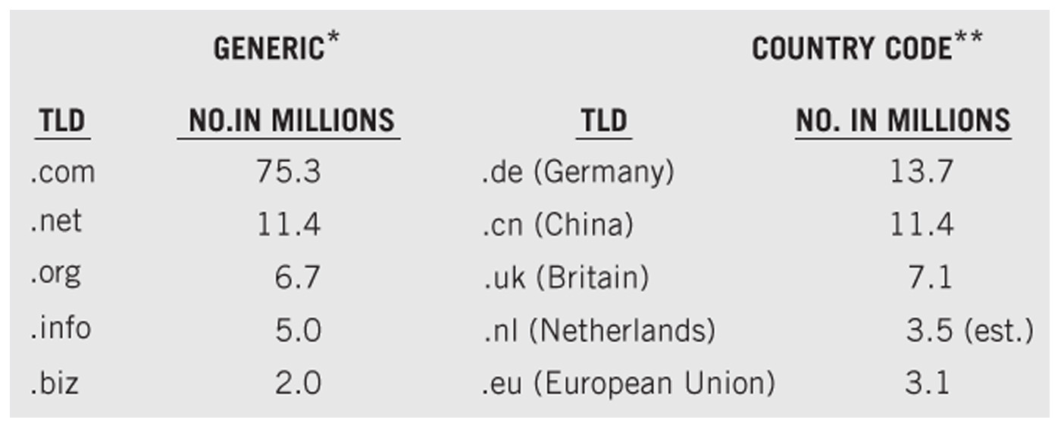
Top Domain Name Registrations

Slide 6
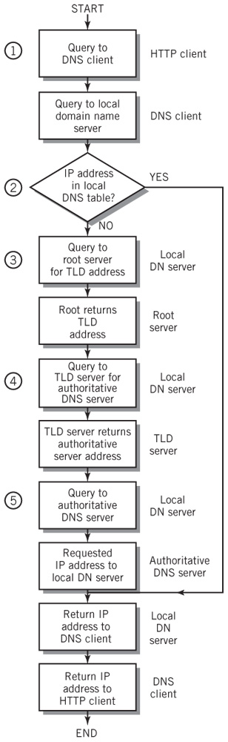
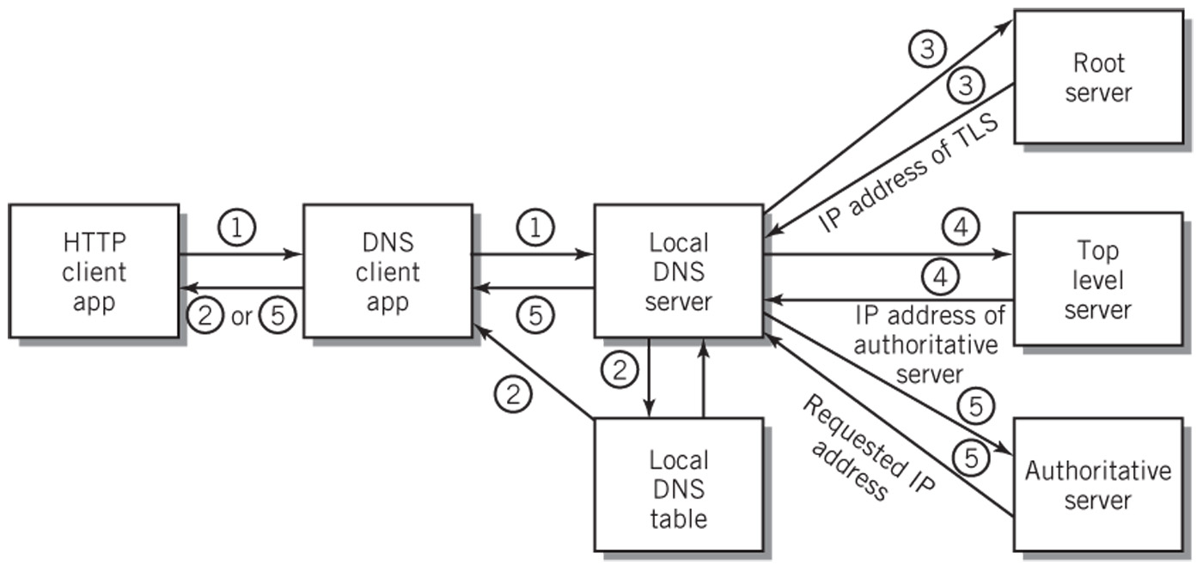
Domain Name Resolution

Slide 7
Transport Layer
TCP protocol
Sends a packet to TCP at the destination site, requesting a connection
Handshaking – back and forth series of requests and acknowledgments
If handshaking negotiations are successful, a connection is opened
Connection is logically full-duplex

Slide 8
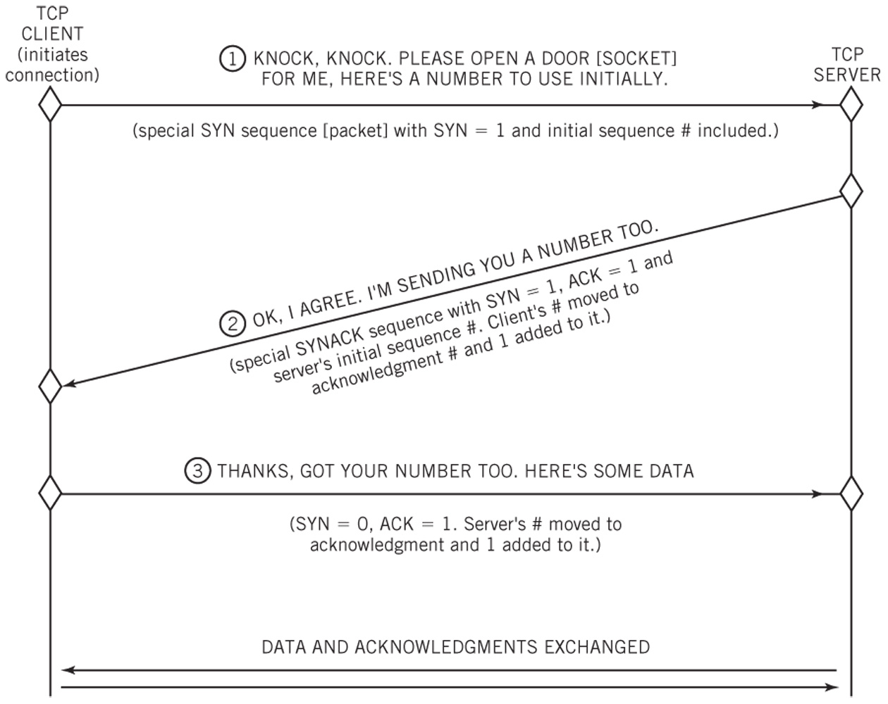
Three-Way TCP Connection Handshake

Slide 9
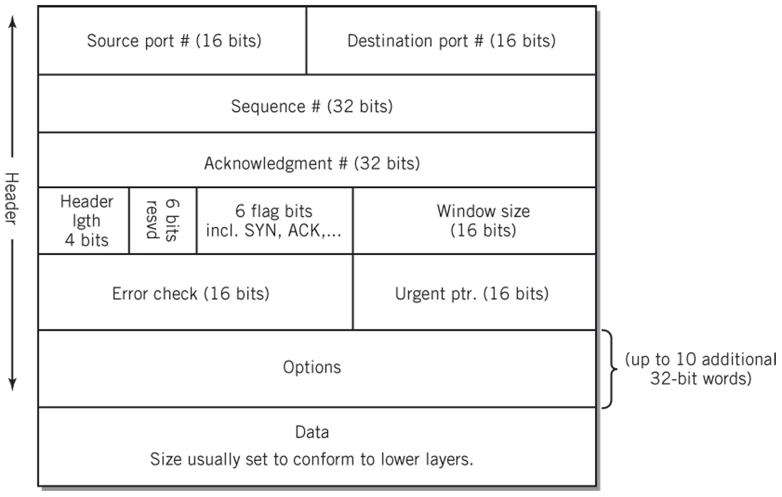
TCP Segment Format

Slide 10
Network Layer
IP protocol
Responsible for relaying packets from the source end node to the destination end node through intermediate nodes
Performed using datagram packet switching and logical IP addresses
Best-attempt unreliable service
Size of datagram ranges from 20 to 65,536 bytes
Header size between 20 and 60 bytes

Slide 11
IPv4 Addresses
Registered and allocated by ICANN
32 bits long divided into 4 octets
Assigned in blocks of contiguous addresses
Number of addresses is a power of two
Divided into three levels
Network address
Subnetworks (subnets)
Hosts (nodes)
Masks
Used to separate the different parts of the address

Slide 12
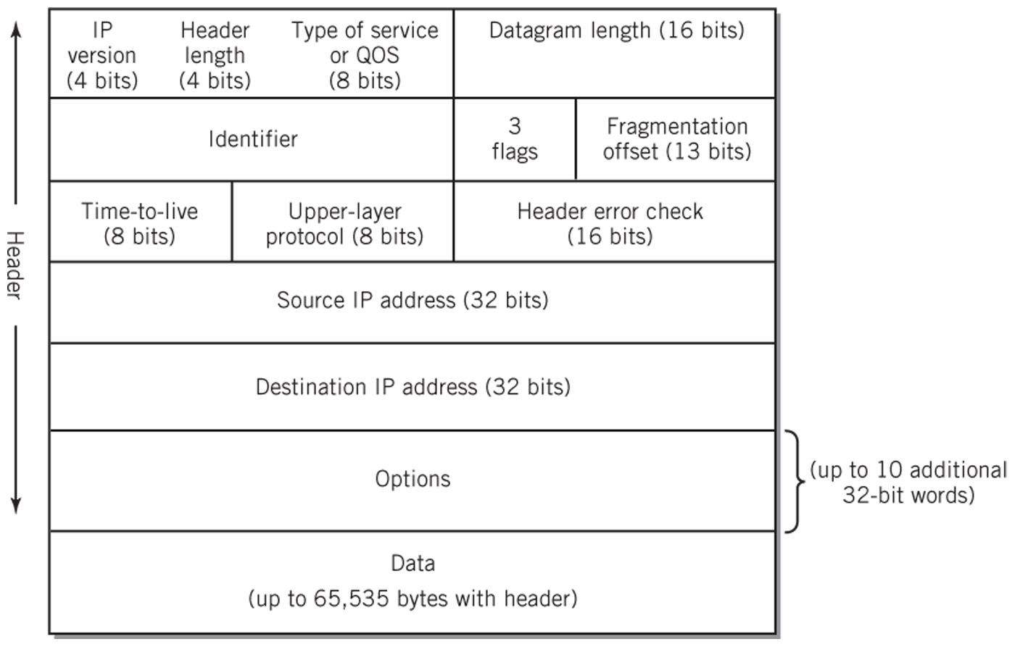
IPv4 Datagram Format

Slide 13
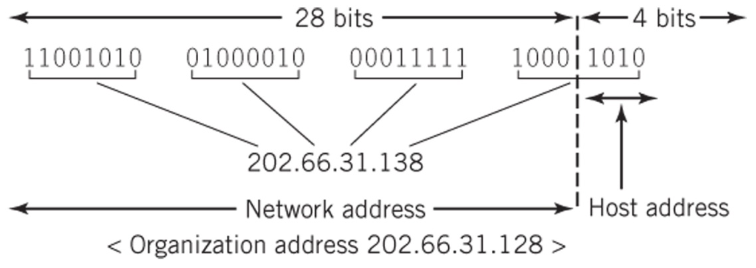
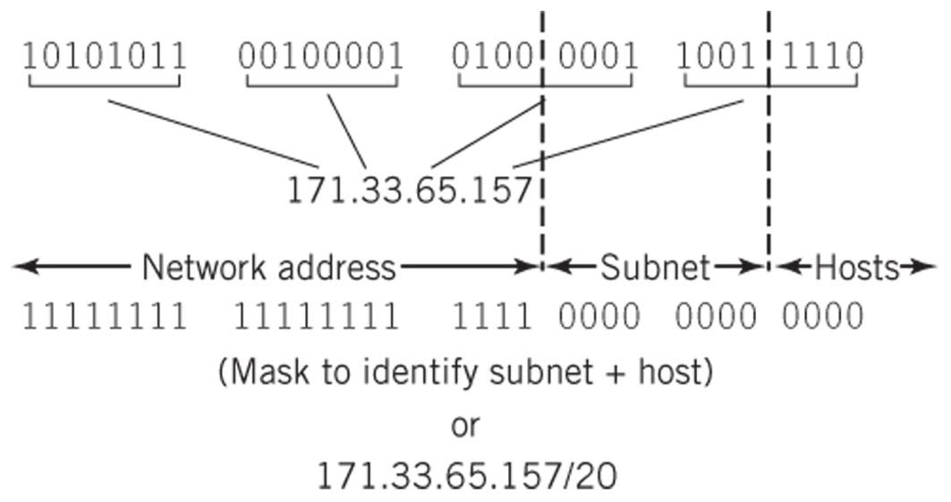
IP Addresses
IP Block Addresses
IP Hierarchy and Subnet Mask

Slide 14
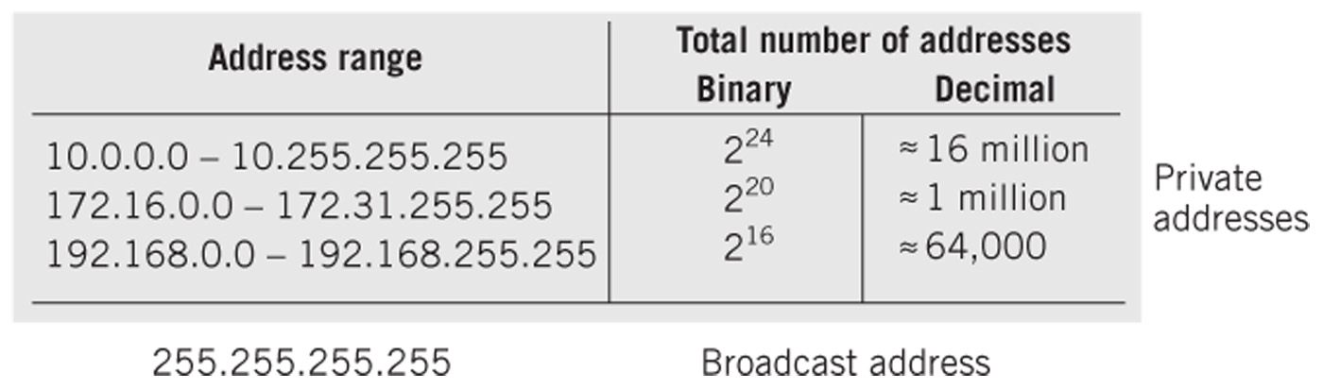
Reseved IP Addresses

Slide 15
DHCP
Two methods to distribute IP addresses more efficiently:
Use of private network IP addresses behind a router
The router must readdress traffic passing between the Internet and the local network
Management of readdressing becomes difficult with large networks
Dynamic Host Configuration Protocol (DHCP)
Maintain a bank of available IP addresses and assign them dynamically to computers for use when the computers are attached to the network
Method often used by large organizations, DSL and cable providers
DHCP client on computer or network device broadcasts a query to locate the DHCP server
DHCP server responds with a lease which includes an IP address, domain name of network, IP address of DNS server, subnet mask, IP address of gateway and other configuration parameters

Slide 16
Operation of IP
Two major functions
Routes datagrams from node to node until they reach their destination node
Translates IP addresses to physical addresses before it passes the packets to the data link later for delivery
Address Resolution Protocol (ARP)
Implemented at the network layer
Translation of IP address to physical address at each intermediate node until destination is reached
A broadcast of the IP address is sent to every node on the network. The matching node responds with a physical address
Physical address (MAC address in the case of Ethernet) is sent in frame to the data link layer
At final destination, the packet is passed up to the transport layer for deployment to the application layer

Slide 17
Data Link Layer
Layer responsible for transmitting a packet from one node to the next node
Node access defined by the medium access control (MAC) protocol
Steer data to its destination
Detect errors
Prevent collisions
Ethernet (CSMA-CD)
Predominant medium-access protocol for local area networks
Standard Ethernet packet is a frame (see next slide)

Slide 18
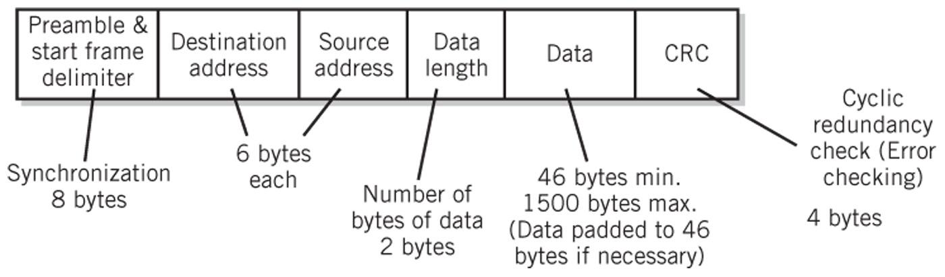
Ethernet Frame

Slide 19
Hub-Based Ethernet
Simple means of wiring a bussed Ethernet together
Logically still a bus network
CSMA-CD
Collision
Occurs when multiple nodes access the network in such a way that their messages become mixed and garbled
Network propagation delay
Amount of time that it takes for one packet to get from one end of the network to the other
Adequate for networks with light traffic

Slide 20
Switched Ethernet
Permits point-to-point connection of any pair of nodes
Multiple pairs can be connected simultaneously
Possible to connect nodes in full-duplex mode
Each pair of connections operates at the maximum bit rate of the network
Why can’t there be any collisions in a switched Ethernet network?

Slide 21
Quality of Service (QoS)
Methods to reserve and prioritize channel capacity to favor packets that require special treatment
Service guarantees from contract carrier services that specify particular levels of throughput, delay and jitter
Jitter – variation in delay from packet to packet
Differentiated service (DiffServ)
8-bit (DS) field in IP header
Set by the application at the sender or by the first node
Diffserv capable nodes such as routers can then prioritize and route packets based on the packet class

Slide 22
Network Security Categories
Intrusion
Keeping network and system resources free from intruders
Confidentiality
Keeping the content of data private
Authentication
Verifying the identity of a source of data being received
Data integrity and non-repudiation
Protecting the content of data communication against changes and verifying the source of the message
Assuring network availability and access control
Keep network resources operational and restricting access to those permitted to use them

Slide 23
Network Security
Network intrusions
Packet sniffers read data in a packet as it passes through a network
Probing attacks to uncover IP address / port numbers that accept data packets
Physical and Logical Restriction
Limit access to wiring and network equipment
Firewall
Private networks
Encryption
Symmetric key cryptography
Both key used for encryption and decryption
Both sender and receiver use the same key which makes security difficult
Public key cryptography
Two different keys are used for encryption and decryption

Slide 24
Alternative Protocols to TCP/IP
MPLS (Multi-Protocol Label Switching)
Creates a virtual circuit over packet switched networks to improve forwarding speed of datagrams
ATM (Asynchronous Transfer Mode)
Partial-mesh network technology in which data passes through the network in cells (53-byte packets)
SONET (Synchronous Optical Network) and
SDH (Synchronous Digital Hierarchy)
Protocol that uses fiber optic to create wide area networks with very high bit rates over long distances
Frame Relay
Slow, wide area network standard

